Slide 1

JAVA PROJECT PRESENTATION
Courier Delivery
Route & Tracking
TEAM MEMBERS :
2620030033 -- T. Varshitha.
2620030147 – K. Moksha sai.

Slide 2






PROJECT ABSTRACT
Six Java modules, one courier workflow
Module 1
Module 2
Defines the problem, input, algorithm, data, and console interaction.
Controls route decisions, status changes, and repeated stop processing.
Module 3
Module 4
Decomposes the workflow into methods, recursion, and arrays.
Models packages, couriers, and routes with objects, abstraction, and exceptions.
Module 5
Module 6
Handles tracking strings, sorting/searching, and file-based event history.
Organizes live data with collections, lambdas, and streams for summaries.

Slide 3

MODULE 1 · COMPUTATIONAL THINKING
From problem to program
Algorithms and flowcharts shape Java structure.
Primitives, variables, operators, and expressions support input, route data, calculations, and output.
CONSOLE I/O · VARIABLES + OPERATORS
Scanner scanner = new Scanner(System.in);
String id = scanner.nextLine();
int stop = scanner.nextInt() + 1;
System.out.printf("%s → stop %d%n", id, stop);

Slide 4



MODULE 2 · CONTROL FLOW
Control flow runs the route logic
Control flow turns package conditions into tracking updates.
Decide
Update
Route loop
if, nested-if, and switch choose delivery actions.
break exits; continue skips unavailable stops.
JAVA · FOR LOOP + IF/ELSE
for (String stop : stops) {
if (stop.equals(nextStop)) status = "OUT_FOR_DELIVERY";
else status = "QUEUED";
}

Slide 5



MODULE 3 · DECOMPOSITION
Methods and arrays split the work
Methods · parameters · return values · recursion · 1D/2D arrays
assignRoute()
updateStatus()
findPackage()
Methods isolate project tasks.
ARRAYS
RECURSION
1D/2D arrays store stops for traversal, search, sums, and counts.
Use a base case and a recursive case.
JAVA EXAMPLE · METHODS + ARRAYS
static int count(String[] a, String z) {
int n = 0;
for (String s : a) if (s.startsWith(z)) n++;
return n;
}
System.out.println(count(new String[]{"A1","B2","A3"}, "A"));

Slide 6
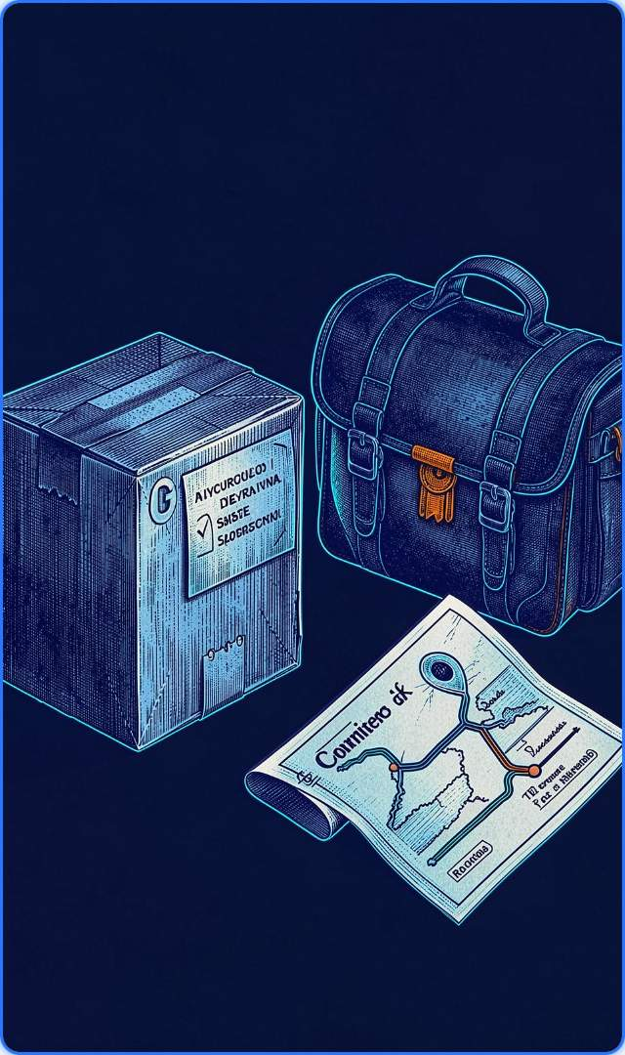
MODULE 4 · OBJECT-ORIENTED DESIGN
Objects create the courier model
Classes · objects · fields · methods · new · constructors · encapsulation · inheritance
Classes model Package, Courier, and Route; objects hold delivery state.
Abstraction: track() and deliver() hide validation and state updates.
Java · Package class & encapsulation
class Package {
private final String id;
Package(String id) { this.id = id; }
String track() { return "Tracking " + id; }
}

Slide 7

MODULE 4 · EXCEPTION SAFETY
Exceptions protect delivery updates
Visible failures keep route history trustworthy.
STATUS UPDATE · TRY/CATCH
Reject invalid changes without losing history.
Exception toolkit
Checked/unchecked exceptions; try-catch-finally; throw/throws.
try {
updateStatus(id, "DELIVERED");
} catch (IllegalArgumentException e) {
log(e.getMessage());
}

Slide 8
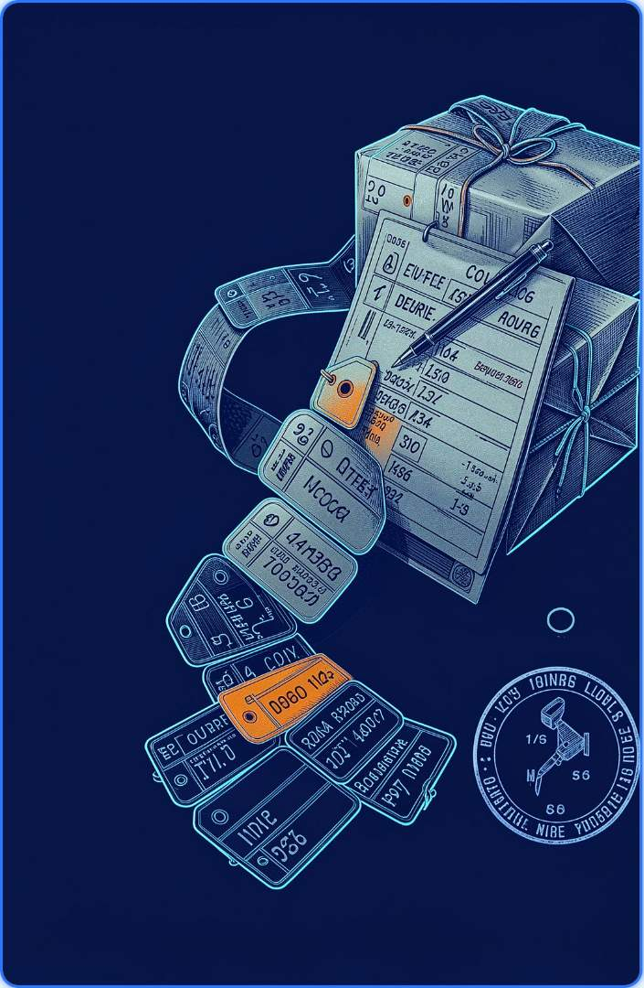
MODULE 5 · TEXT, ALGORITHMS, FILE I/O
Strings and files store the route history
Text becomes ordered records and a reusable event log.
01
02
03
04
Parse
Compare
Order
Persist
split(), trimming, indexing, and validation read records.
equals() checks IDs correctly; == does not replace it.
Sort packages with arrays, collections, or comparators.
Path/Files append and save history.
Malformed records should not break the complete log.
JAVA · STRING PARSING + FILE I/O
String[] p = "PKG-42|OUT_FOR_DELIVERY".split("\\\\|");
Path log = Path.of("route.log");
Files.writeString(log, p[0] + " " + p[1] + "\n", CREATE, APPEND);
System.out.println(Files.readString(log));

Slide 9
MODULE 6 · COLLECTIONS & STREAMS
Collections and streams summarize tracking
Use List for ordered packages, Set for unique stops, and Map for package statuses.
STREAM PIPELINE
filter → map → sorted → distinct → collect
Generics, iterators, lambdas, and functional interfaces support live data.
SUMMARY OPERATIONS
groupingBy, counting, joining, and reduce for route reports.
TYPED COLLECTION + STREAM COUNT
List<String> s = List.of("DELIVERED", "IN_TRANSIT", "DELIVERED");
long delivered = s.stream().filter("DELIVERED"::equals).count();
System.out.println(delivered);

Slide 10
END-TO-END MODULE MAP
From input to tracking report
Module 1
Module 2
Module 3
Define data and read input.
Make route and status decisions.
Divide tasks into methods and arrays.
Module 4
Module 5
Module 6
Hide complexity behind objects and abstraction; handle exceptions.
Parse, sort, search, and persist tracking events.
Collect, filter, and summarize live delivery data.
FINAL CODE IDEA
Map<String,String> statusById = new HashMap<>();

